Slide 1
Time Series Analysis with Python

Slide 2
Time Series vs Linear Models
Linear Models - We try to map the target/dependent variable as a output of an combination of multiple independent variables
What if the independent variables are too complex to understand and are too many ?
What if we don't really care about what variables are are of importance ?
Time Series then comes into the picture, when rather than the independent variables, the dependent variable is more dependent on the time

Slide 3
Examples of Time Series Data
Daily Stock prices
Sales/Revenue/Profits
Demographic data like Population
And many more...

Slide 4
So What exactly is Time Series Data?
The datasets that on visualization or observations show the following characteristics
Trends
Seasonality
Long-Term Cyclicity
Autocorrelation
Stochasticity

Slide 5
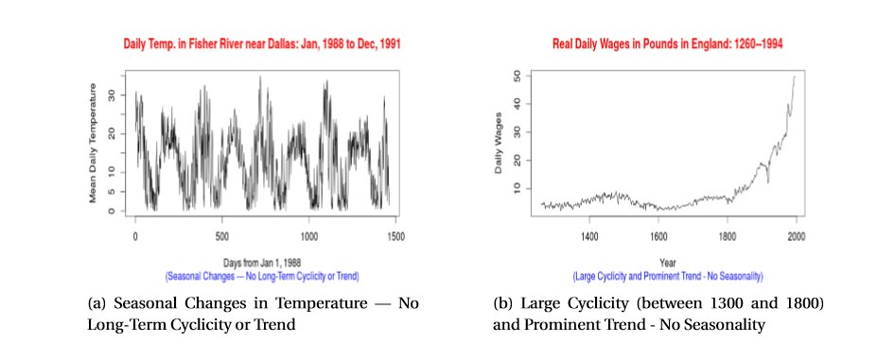

Slide 6
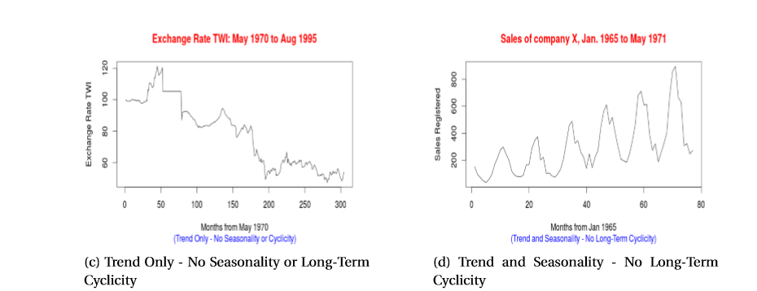

Slide 7
Classifical Ways
Additive and Multiplicative Models
AR Models
MA Models
ARIMA Models

Slide 8
AR + MA = ARIMA
AR - Autoregressive
MA - Moving Averages
ARIMA - Autoregressive Integrated Moving Average

Slide 9
ARIMA : p - d - q (plus) P - D- Q
p is the auto-regressive part of the model. It allows us to incorporate the effect of past values into our model. Intuitively, this would be similar to stating that it is likely to be warm tomorrow if it has been warm the past 3 days.
d is the integrated part of the model. This includes terms in the model that incorporate the amount of differencing (i.e. the number of past time points to subtract from the current value) to apply to the time series. Intuitively, this would be similar to stating that it is likely to be same temperature tomorrow if the difference in temperature in the last three days has been very small.
q is the moving average part of the model. This allows us to set the error of our model as a linear combination of the error values observed at previous time points in the past.

Slide 10
Parameter Tuning and Codes…...!

